Slide 1

Multi Camera Tracking Project
Spring 2025 – Bi weekly progress, 15 May, 2025

Slide 2
Agenda
Recap
Progress Overview
Analysis on Trace-1573 dataset
Developed targeted pipelines to identify failure modes
Generated detailed reports for manual verification
Conclusion
Next steps

Slide 3
Recap
Failure Cases of Clip ReID​
(Low resolution , multi person detections, missing body parts , Label inconsistencies)
Clip ReID performance on filtered query and gallery sets ​
Visualization of feature distances between query and Top-5 gallery matches ​
Data augmentations in training Clip ReID model​

Slide 4
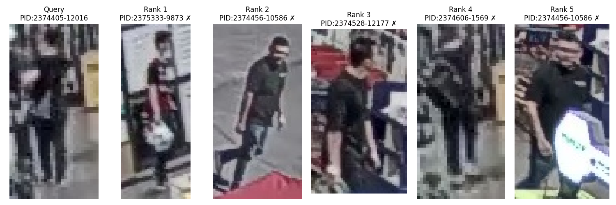
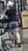
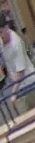
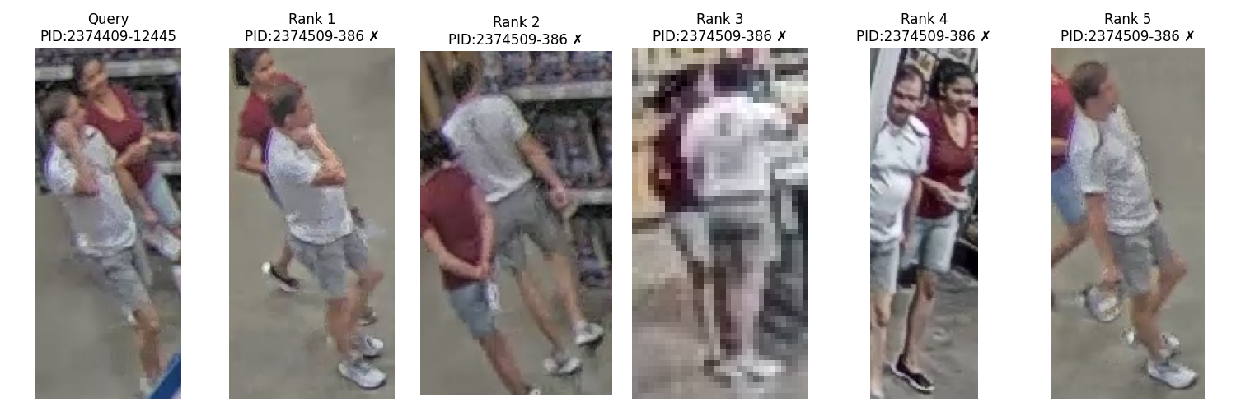
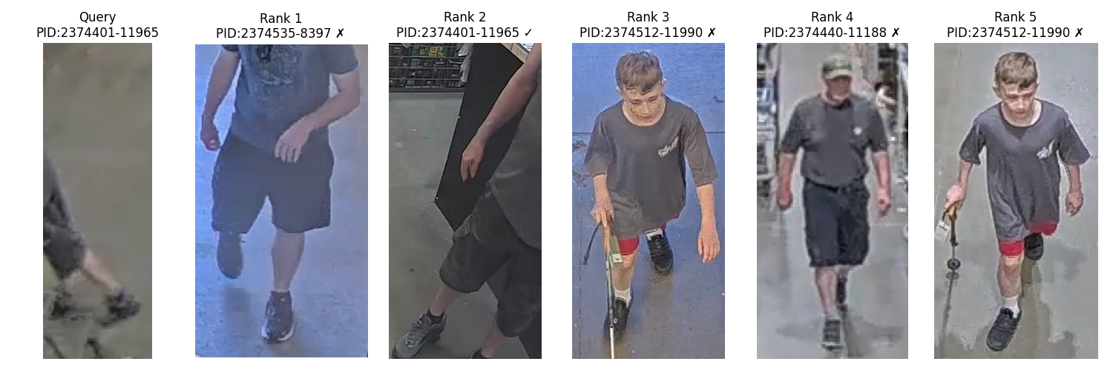
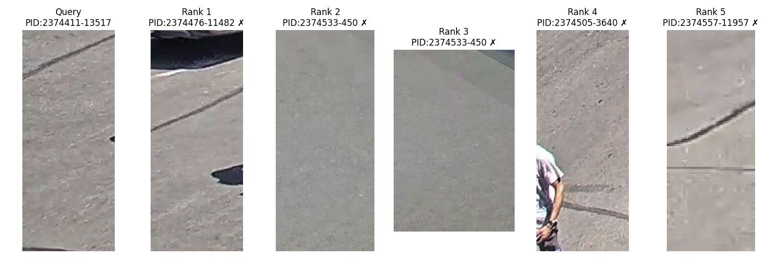
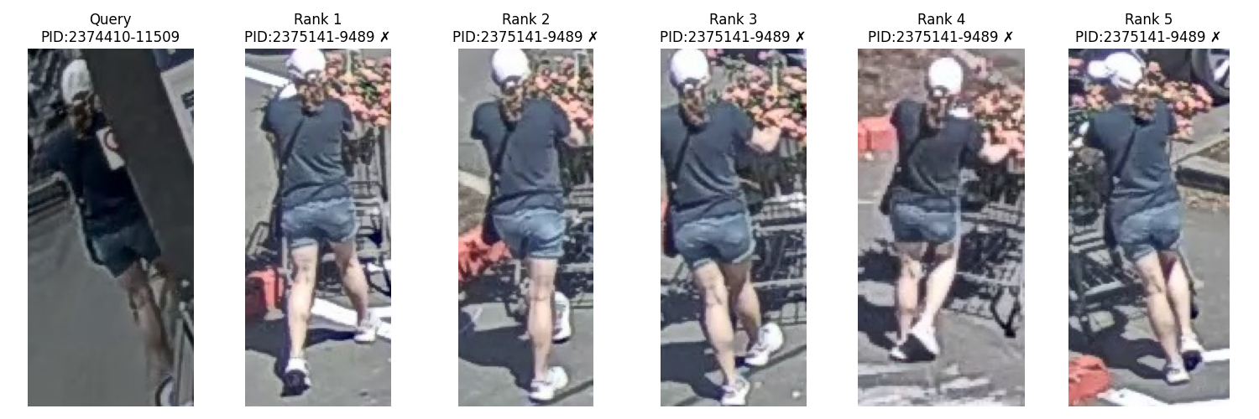
Recap
Low Resolution
Multi Person overlapping
No person detections/ Few body parts
Label inconsistency

Slide 5
Progress
Extensive analysis of Trace-1573 reid data failure cases across the following categories:
Low-resolution subjects
Multiple person detections in a single frame
Lookalike identity mismatches
Missing person within ground-truth bounding boxes
Label inconsistencies
Developed targeted pipelines to:
Isolate cases with missing person detections despite bounding box annotations
Narrow down and identify potential label inconsistency cases
Generated detailed reports highlighting suspect cases for manual verification by the labeling team

Slide 6
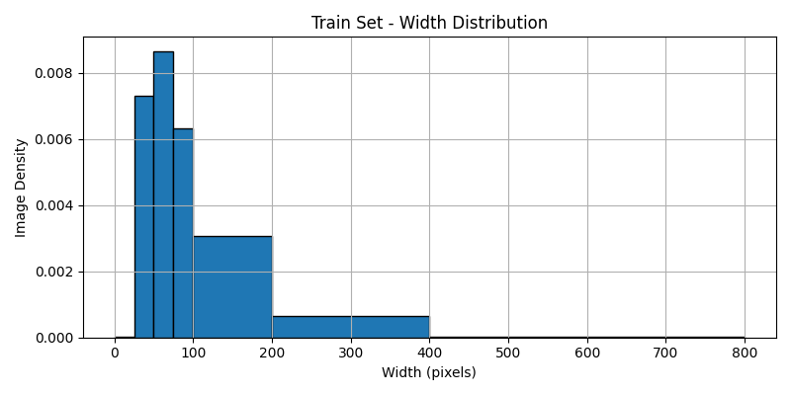
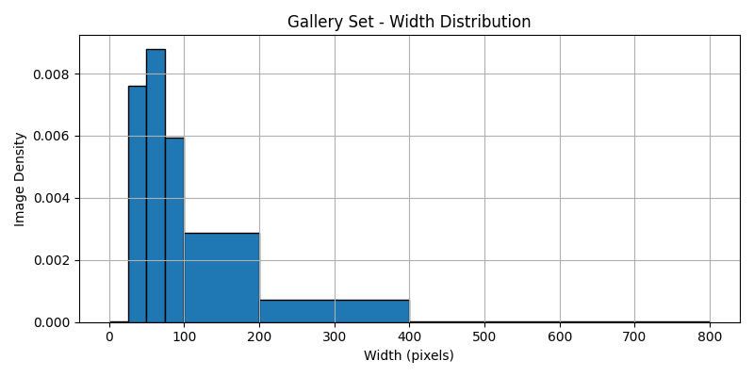
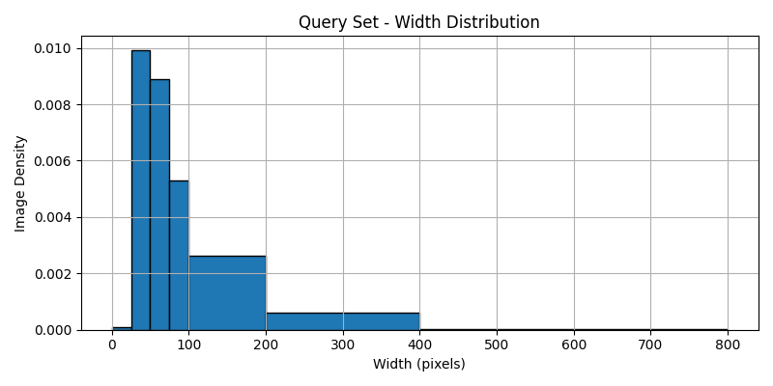
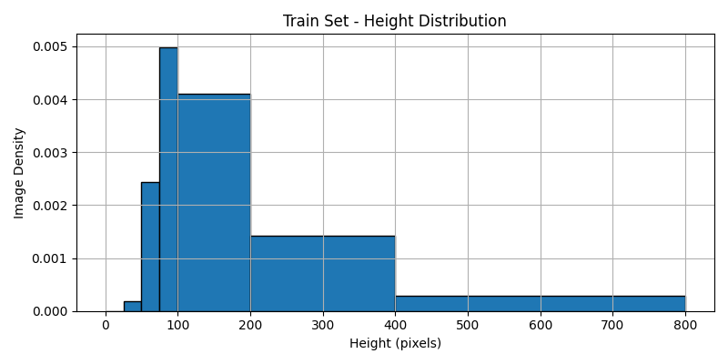
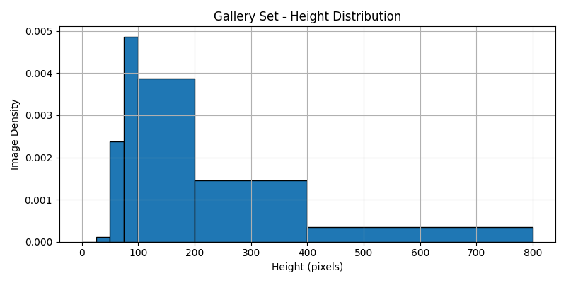
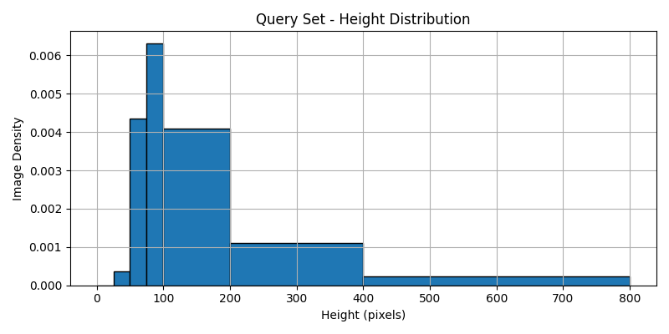
Subject Resolution Distribution of Trace-1573 Data
Train
Gallery
Query
Mean – 213
Std - 146
Mean –106
std - 80
Mean – 116
Std - 157
Mean - 214
Std - 146
Mean - 192
Std - 144
Mean –226
Std - 157
Does spatial distribution of bounding boxes differ in various splits of data?
"Train , Query , Gallery sets show consistent/similar spatial distributions of bounding boxes"

Slide 7
CLIP-ReID: Subject Resolution-Based Analysis
Total query images : 4099
Correct predictions - 2731 Incorrect predictions - 1368
Min Resolution(HxW) | No of Images
200-800 x 200-800 | 308
<=200x<=200 | 2423
<=100x<=100 | 1632
<=50x<=50 | 534
Min Resolution(HxW) | No of Images
200-800 x 200-800 | 142
<=200x<=200 | 1226
<=100x<=100 | 1004
<=50x<=50 | 527
Around 20% of the correct predictions and 40% of the incorrect predictions has resolution less than 50x50 which can be considered low subject resolutions.
Notes:
124x64
887

Slide 8
CLIP-ReID: Subject Resolution-Based Analysis
Total query images : 4099
Correct predictions - 2731 Incorrect predictions - 1368
Min Resolution(HxW) | No of Images
200-800 x 200-800 | 308
<=200x<=200 | 2423
<=100x<=100 | 1632
<=50x<=50 | 534
Min Resolution(HxW) | No of Images
200-800 x 200-800 | 142
<=200x<=200 | 1226
<=100x<=100 | 1004
<=50x<=50 | 527
Around 20% of the correct predictions and 40% of the incorrect predictions has resolution less than 50x50 which can be considered low subject resolutions.
When does CLIP-ReID succeed or fail on low-resolution, and can these cases be systematically categorized? We would like to further investigate how such success / failure cases look like !!
Notes:
124x64
887

Slide 9
Resolution statistics on CLIP-ReID predictions
Total query images : 4099
Correct predictions - 2731 Incorrect predictions - 1368
Min Resolution(HxW) | No of Images
(200-800 x 200-800) | 308
<=200x<=200 | 2423
100x100 | 1632
50x50 | 534
Min Resolution(HxW) | No of Images
(200-800 x 200-800) | 142
<=200x<=200 | 1226
100x100 | 1004
50x50 | 527
Here , even with correct predictions there exists 20% images that have 50x50 resolution. We would like to further investigate how such positive / negative cases look like !!
Notes:
124x64
887

Slide 10
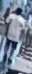
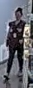
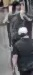
Examples : Low Subject Resolutions
<= 50x50 Resolution Images
Due to low resolutions, it's difficult even for our naked eye to re-identify subjects.

Slide 11
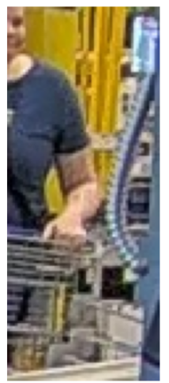
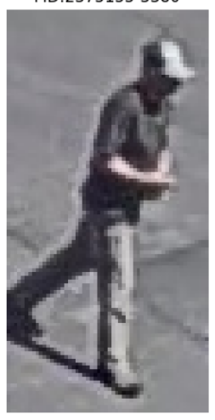
Detections - Body Part Visibility
More is the visibility of body parts, better is the performance.
Min Keypoints | Query set | Gallery set | mAP | Top-1
8 | 1856 | 9152 | 78.0 | 90.4
9 | 1743 | 8873 | 78.5 | 90.1
10 | 1608 | 8409 | 79.3 | 90.1
11 | 1484 | 7938 | 81.3 | 91.9
12 | 1302 | 7179 | 82.0 | 91.2
While analyzing the number of minimum body joints using yolo pose estimator.
Identified cases like No persons / multi person detections
Do we have any cases where there is no person i.e no joints from pose estimator based on GT annotations?

Slide 12
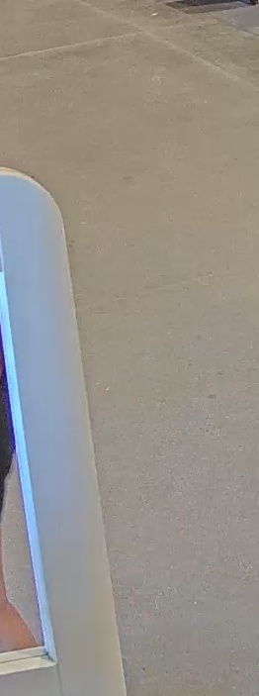
Pipeline for No Person Detection
Total query images : 4099
Incorrect predictions - 1368
Followed a two-stage pipeline (object detection + pose estimation ) to identify persons in GT bounding boxes
Detector
No Person?
No Person Detected
Manually Verification for False Negatives
Pose Estimator
GT Box
maybe detector / pose estimator doesn't work due to low resolution/occlusions
No Joint?

Slide 13
Pipeline for No Person Detection
Focused on failed cases in query images only - 1368 cases (because of manual verification step)
943 images have person detections and 425 images have no detections.
When manually checked these 100 out of 425 images (7.5% of no person detection cases) actually have no persons detected and remaining are false negatives from the object detection model
Similarly, we log the detection information for both train and gallery sets and can be reviewed manually by label team.
Detector
No Person?
No Person Detected
Manually Verification for False Negatives
Pose Estimator
GT Box
maybe detector / pose estimator doesn't work due to low resolution/occlusions
No Joint?

Slide 14
Pipeline for No Person Detection
Total query images : 4099
Incorrect predictions - 1368
Followed a two-stage pipeline (object detection + pose estimation ) to identify persons in GT bounding boxes
943 images have person detections and 425 images have no detections.
When manually checked these 100 out of 425 images actually have no persons detected and remaining are false negatives from the object detection model
Similarly , we log the detection information for both train and gallery sets and can be reviewed manually by label team .

Slide 15
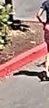
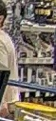
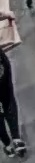
Examples : False negatives
Low subject resolutions
Very few body parts
Around 23%, we have false negatives cases for no person detection due to occlusions, missing body parts, low resolution.

Slide 16
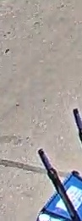
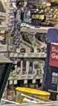
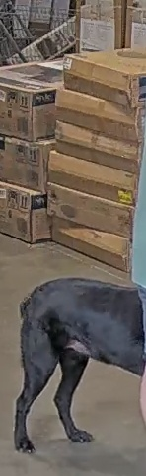
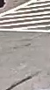
Examples : No Person Detections
Around 7%, we have no person detection issue in failure cases of query. How much issue is prevalent in training and gallery images?

Slide 17
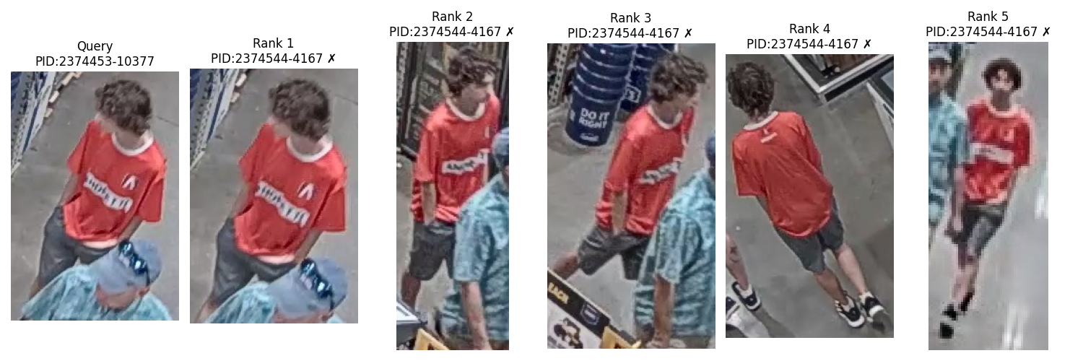
Multi Person Detections
Around 532 out 4099, we have multi-person detection issue in query set. How much issue is prevalent in training and gallery images?
We also aim to categorize multi-person cases where the model correctly performs re-identification and identify scenarios where it fails.

Slide 18
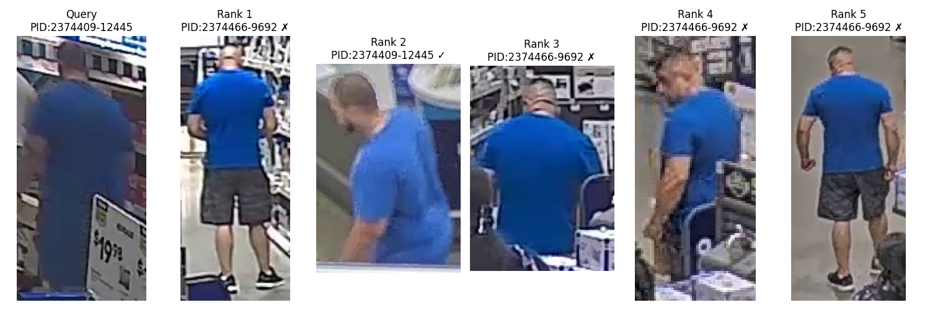
Lookalike Matches
Visually similar and ReID embeddings are closer , but the sample are of different persons

Slide 19
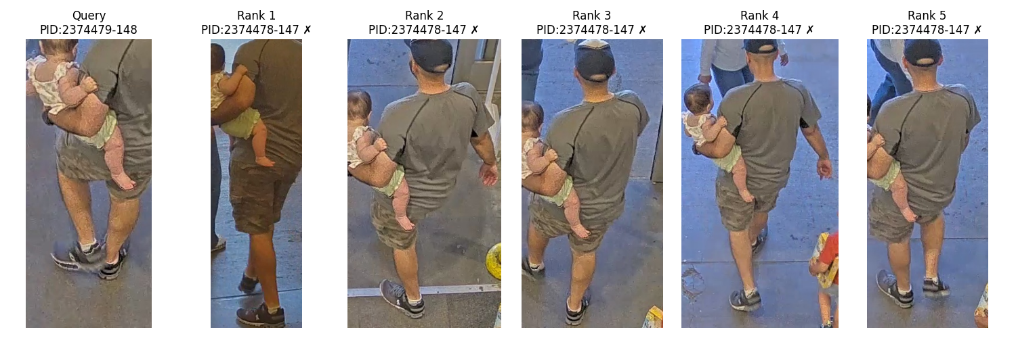
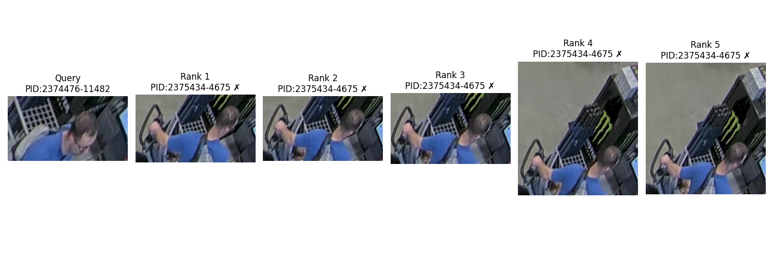
Label Inconsistency
Query Pid : 2374479-148
Gallery Pid : 2374479-147
Query Camera : Entry PCA
Gallery Camera : Entry PVM
Embedding distance : 0.07
Query Pid : 2374476-11482
Gallery Pid : 2375434-4675
Query Camera : Term Front End
Gallery Camera : Term Front End
Embedding distance : 0.05
On an average , 250-500 out of 4099 images have label inconsistencies in query set

Slide 20
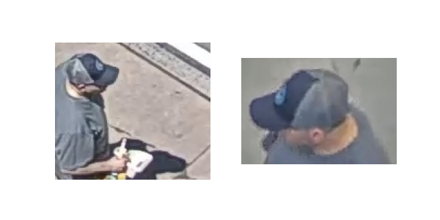
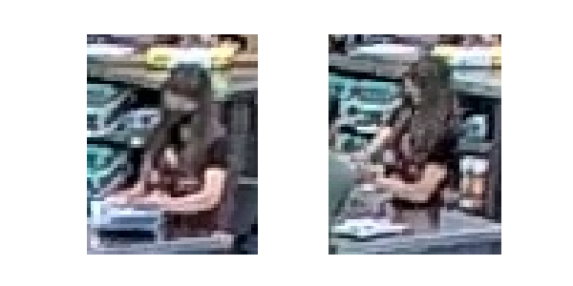
Label Inconsistency
Query Pid : 2374506-11521
Gallery Pid : 2375443-10042
Query Camera : Parking LotCam2
Gallery Camera : Term Front End
Embedding distance : 0.09
Query Pid : 2375450-12253
Gallery Pid : 2375466-7112
Query Camera : ToolworldPTZ
Gallery Camera : ToolworldPTZ
Embedding distance : 0.05

Slide 21
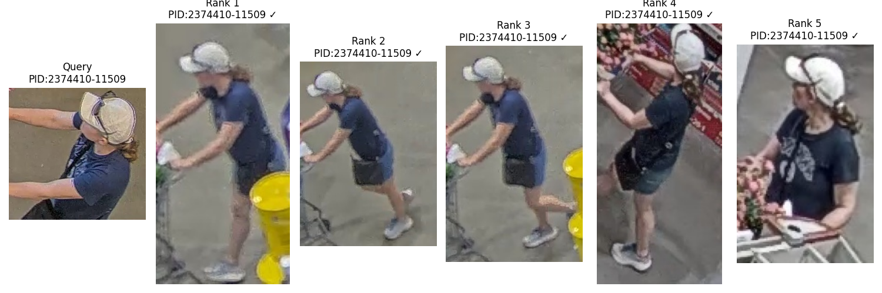
Comparision with Correct Labelling
2374410-11509
2374410-11509
Query Pid : 2374410-11509
Gallery Pid : 2375141-9489
Query Camera : Exit PCA
Gallery Camera : ParkingLot cam3
Embedding distance : 0.07
Query Pid :2374410-11509
Gallery Pid : 2374410-11509
Query Camera : TermFrontEnd
Gallery Camera : Entry PVM​
Embedding distance : 0.07

Slide 22
Label Inconsistency-Verification pipeline
Based on threshold and Incorrect ID flag the samples
Trace 1573 Reid dataset
Extract CLIP-Reid embeddings
Compute Feature distance between images

Slide 23
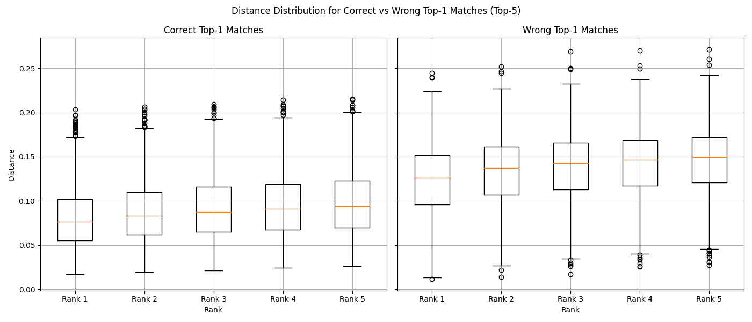
Feature Distance Distribution of Top1 Matches
Correct Top-1 Matches:
Rank 1: Mean = 0.0811, Std = 0.0331
Wrong Top-1 Matches:
Rank 1: Mean = 0.1230, Std = 0.0387

Slide 24
Label Inconsistency Statistics
Dataset size : Train(12720 ) , Gallery(14976) , Query(4099) = (31795)
Distance Threshold | Total data samples with inconsistency | Unique person-camera pairs | % of samples with inconsistency
0.06 | 2796 | 711 | ~9%
0.08 | 6417 | 1695 | ~20%
0.10 | 11591 | 3866 | ~36%
Person-camera pair : for each inconsistency case , I created a pair with (correct personId_camId , wrong personId-camID)
We will include additional high-similarity threshold results and generate reports at various thresholds to help the labeling team efficiently verify cases with a high likelihood of inconsistency.

Slide 25
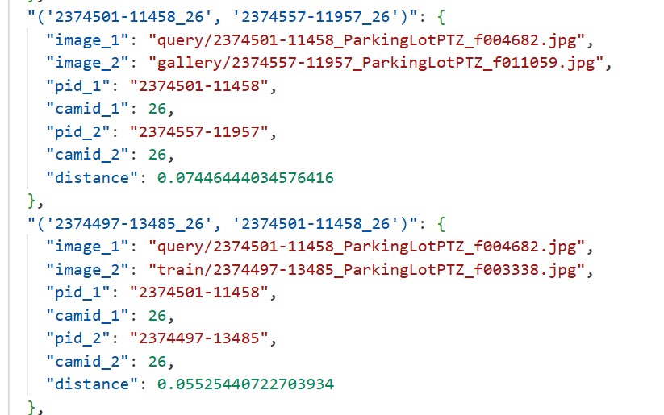
Label Inconsistency log

Slide 26
Key Takeaways
Train , Query , Gallery sets show consistent/similar spatial distributions of bounding boxes
Around 20% of the correct predictions and 40% of the incorrect predictions has resolution less than 50x50 which can be considered low subject resolutions.
Due to low resolutions, it's difficult even for our naked eye to re-identify subjects.
Atleast 7%(425) of incorrect predictions query have no person detection issue .
When manually checked these 425 images , 100 actually have no person detections.
Around 23%, we have false negatives cases for no person detection
532 out 4099 images have multi-person detection issue in query set.
On an average , 20% of samples have label inconsistencies in entire dataset

Slide 27
Next Steps
Finding out where CLIP-ReID succeed or fail on low-resolution, and systematically categorizing such cases
Finding total number of multi-person detections in overall dataset
Explore attribute-aware ReID models to better distinguish the person ids (like incorporate clothing information , etc)
Train with augmented appearance diversity (similar clothes , different views) data.
Introduce different rotations in real images

